Slide 1
Classification: Basic Concepts and KNN

Slide 2
A programming task

Slide 3
Classification: Definition
Given a collection of records (training set )
Each record contains a set of attributes, one of the attributes is the class.
Find a model for class attribute as a function of the values of other attributes.
Goal: previously unseen records should be assigned a class as accurately as possible.
A test set is used to determine the accuracy of the model. Usually, the given data set is divided into training and test sets, with training set used to build the model and test set used to validate it.

Slide 4
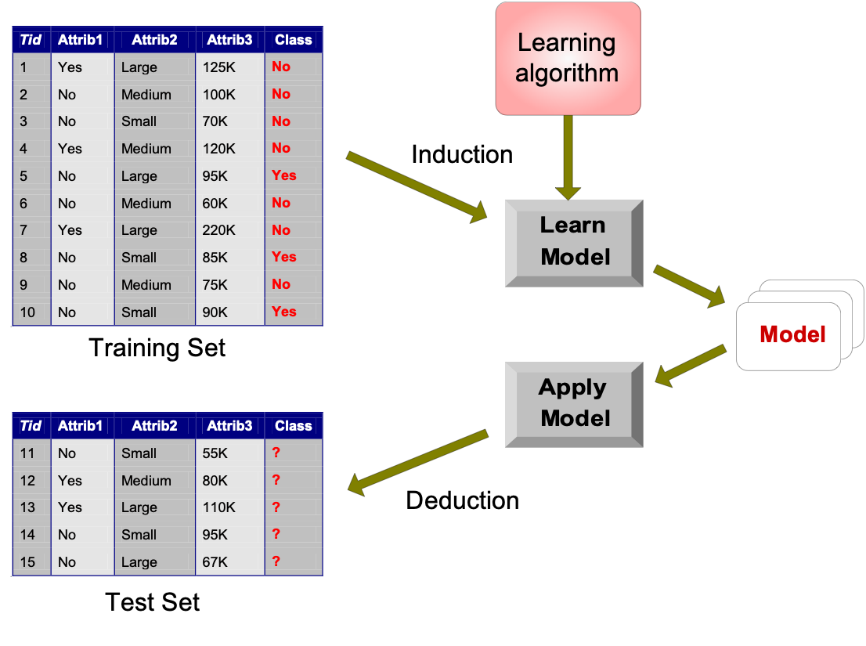
Illustrating Classification Task

Slide 5



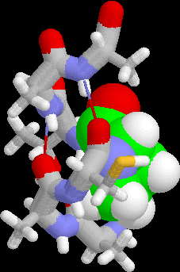
Examples of Classification Task
Predicting tumor cells as benign or malignant
Classifying credit card transactions as legitimate or fraudulent
Classifying secondary structures of protein as alpha-helix, beta-sheet, or random coil
Categorizing news stories as finance, weather, entertainment, sports, etc

Slide 6
Classification Using Distance
Place items in class to which they are “closest”.
Must determine distance between an item and a class.
Classes represented by
Centroid: Central value.
Medoid: Representative point.
Individual points
Algorithm: KNN

Slide 7
K Nearest Neighbor (KNN):
Training set includes classes.
Examine K items near item to be classified.
New item placed in class with the most number of close items.
O(q) for each tuple to be classified. (Here q is the size of the training set.)

Slide 8
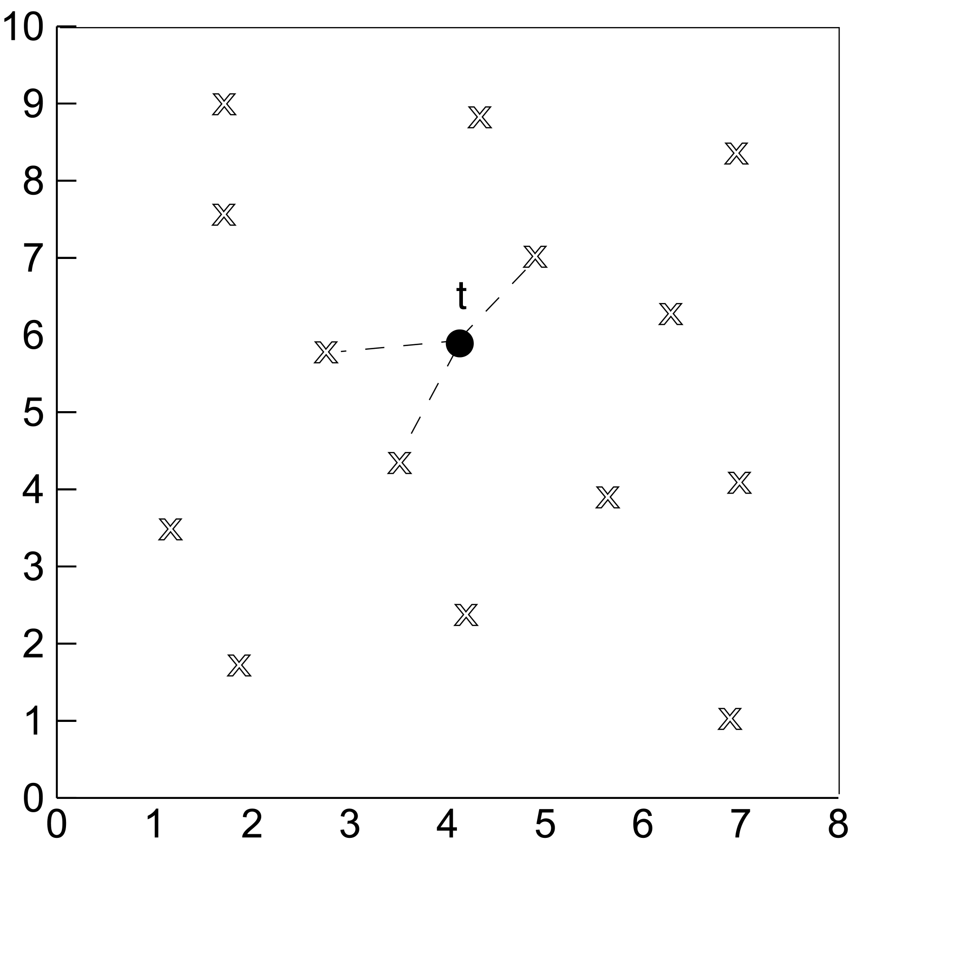
KNN

Slide 9
1-Nearest Neighbor
One of the simplest of all machine learning classifiers
Simple idea: label a new point the same as the closest known point
Label it red.

Slide 10
k – Nearest Neighbor
Generalizes 1-NN to smooth away noise in the labels
A new point is now assigned the most frequent label of its k nearest neighbors
Label it red, when k = 3
Label it blue, when k = 7

Slide 11
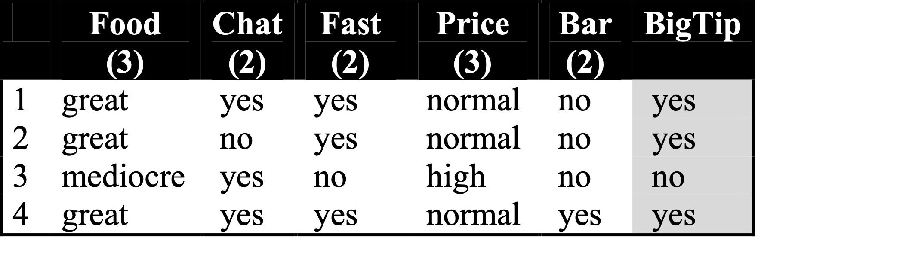
KNN Example
Similarity metric: Number of matching attributes (k=2)
New examples:
Example 1 (great, no, no, normal, no)
Example 2 (mediocre, yes, no, normal, no)
Yes
→ most similar: number 2 (1 mismatch, 4 match) → yes
→Second most similar example: number 1 (2 mismatch, 3 match) → yes
Yes/No
→ Most similar: number 3 (1 mismatch, 4 match) → no
→Second most similar example: number 1 (2 mismatch, 3 match) → yes
Notes:
Distance metric: Number of matching attributes
Example 1:
Most similar example: number 2 (1 mismatch, 4 match) -> classify yes
Second most similar example: number 1 (2 mismatch, 3 match) -> classify yes
Example 2:
Most similar example: number 3 (1 mismatch, 4 match) -> classify no
Second most similar example: number 1 (2 mismatch, 3 match) -> classify yes/no

Slide 12
Selecting the Number of Neighbors
Increase k:
Makes KNN less sensitive to noise
Decrease k:
Allows capturing finer structure of space
➔Pick k not too large, but not too small (depends on data)

Slide 13
Advantages and Disadvantages of KNN
Need distance/similarity measure and attributes that “match” target function.
For large training sets,
→ Must make a pass through the entire dataset for each classification. This can be prohibitive for large data sets.
Prediction accuracy can quickly degrade when number of attributes grows.
Simple to implement algorithm;
Requires little tuning;
Often performs quite weel!
(Try it first on a new learning problem).
Notes:
Need similarity measure and attributes that “match” target function
predicting a person’s height may depend on different attributes than predicting their IQ

Slide 14
Example - Tissue Paper Good or Bad
X1 = Acid Durability | X2 = Strength | Y = class
7 | 7 | Bad
7 | 4 | Bad
3 | 4 | Good
1 | 4 | Good

Slide 15
K = 3 New Instance = (3,7)
X1 = Acid Durability | X2 = Strength | Distance
7 | 7 | (7-3)^2 + (7-7)^2 =16
7 | 4 | (7-3)^2 + (4-7)^2 =25
3 | 4 | (3-3)^2 + (4-7)^2 =9
1 | 4 | (1-3)^2 + (4-7)^2 =13

Slide 16
Prediction
Nearest Neigbours = 1(Bad),3(Good) and 4(Good)
Prediction = Good

